Slide 1


A Primer on Python Survival Debugging your way to success
Soheb Mandhai

Slide 2

Resources – Follow Along
Github Repo: https://github.com/smandhai/Astro-Data-Handling-Tutorials
Aim: To make you aware of what python can do for you. It’s up to you to follow up these threads and read the documentation!

Slide 3
Getting Started

Slide 4



Installation
Vanilla:
https://www.python.org/
Download > Choose the python version > Pick the appropriate installer for your OS
Note: You will need to install non-standard packages manually
Anaconda (Recommended):
Go to https://www.anaconda.com/products/distribution
Choose the appropriate installation for your OS
Benefit: Comes pre-shipped with most scientific packages, ready to use. Also comes with Spyder IDE.

Slide 5
ENVIRONMENTS

Slide 6

What are environments? (BASIC)
Local python installations
Bespoke packages installed – Can use pip/conda
Lightweight
Reproducible
Great for development environments

Slide 7

Built In Environment Handlers
venv – Included with Python > 3.3. Creates lightweight environments.
Usage: python –m venv myenv
virtualenv – Older but more feature-rich than venv
Usage: virtualenv myenv
pyenv – Used to manage python versions and installations
Usage: pyenv install 3.XX.X

Slide 8
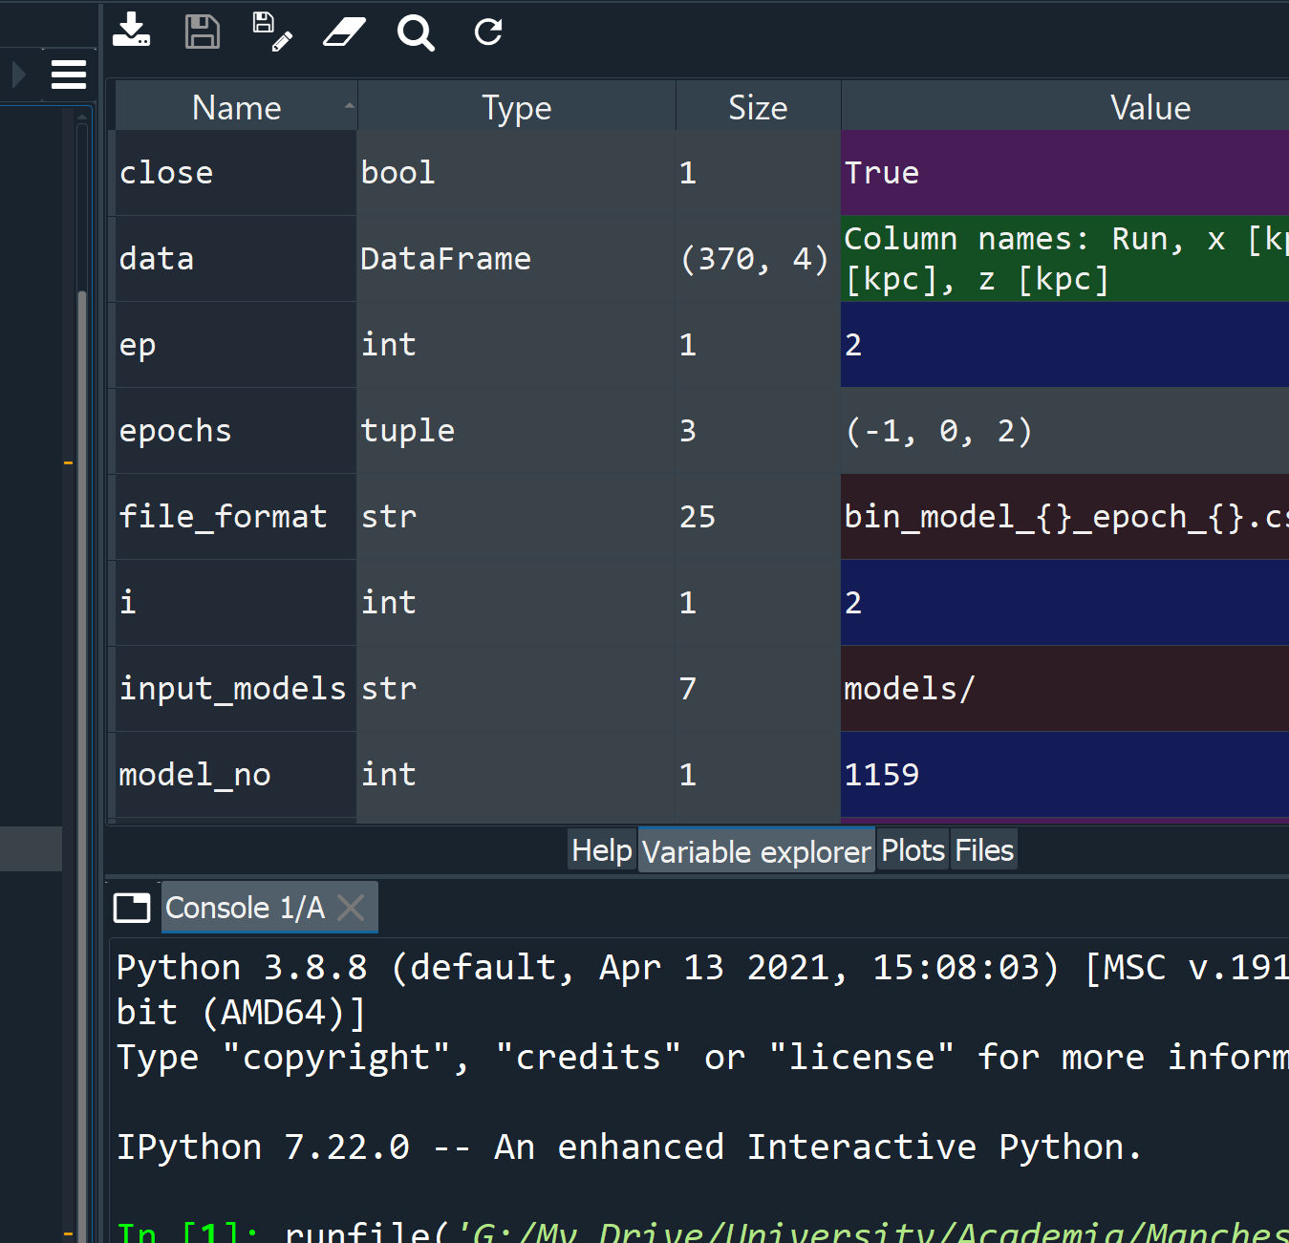
Additional Quick Notes:
Environment Control:
Can create backups of your installed packages
Can create isolated environments to test software
Can be used to minimise bloatware when shipping applications
IDEs – Integrated Development Environments
Excellent for testing
Debugging tools
Useful for managing code and identifying errors/typos early on
Variable display is useful for looking at stored values
Can run multiple instances of a code quickly
Python Script Available Here: https://drive.google.com/file/d/1WXiNCu9LGAA7ljnuDQ88cZBvS8TcGb12/view?usp=sharing

Slide 9
Tangent: Types of Functions and OBjects

Slide 10

Lambda
A small anonymous function
Can take many arguments but consists of one expression
Useful for mathematical operations
Python reference – lambda
Example:

Slide 11
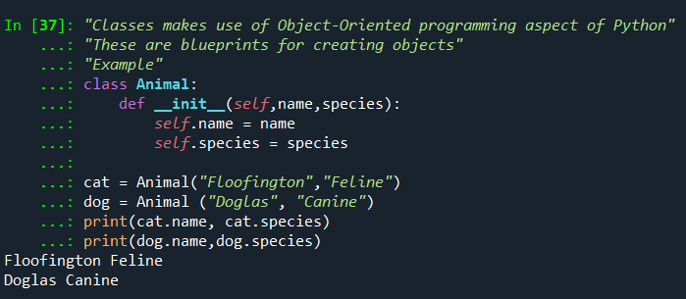
Classes
Makes use of Object-Oriented programming methods
Blueprints for creating objects/instances
Useful for creating complicated registries for subjects
Example:
__init__ is a special “method” to initialise the class
self is used to refer to variables unique to the class “instance”
Create instances of a class
Recalling variables stored in a class

Slide 12

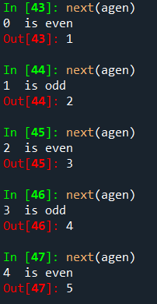
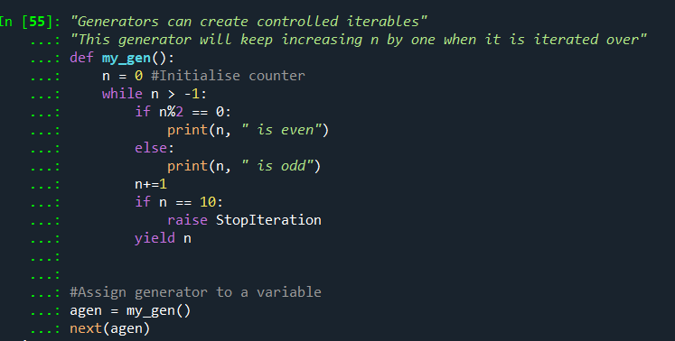
Generators
Useful for controlling iterations over a code block – like a for loop
Uses yield methods
Has special routines
You can use for loops to iterate over generators!
Stopping condition prevents generator from running forever

Slide 13
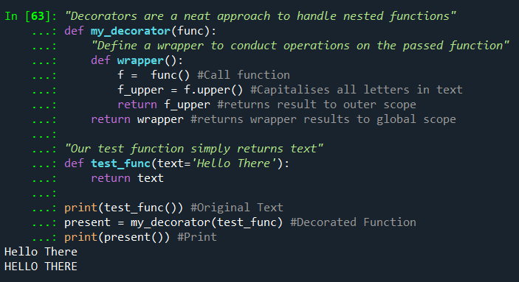
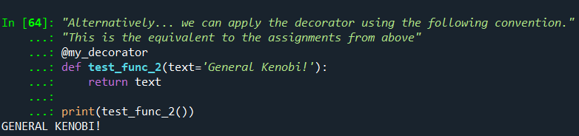
Decorators (BASIC)
An approach to handling nested functions!
A quick way to modify different functions with the same function (wrapper)
A simpler way of wrapping a function!

Slide 14
Parallelisation (BASIC)

Slide 15
Parallelisation – General Notes
Serial (e.g. for loops) vs Parallelisation (e.g. map)
Threads vs Processors (GIL = Global interpreter Lock)
Queuing is essential when doing multi-threading!
map: Python’s in-built map function lets you parse an array of arguments and apply a function to them sequentially.
MPI - lets multiple programs or processes work together and share data across computers to perform tasks in parallel.
Threads | Processes
Share the same memory space | Have separate memory spaces
Lightweight and fast to start | Heavier and slower to start
Limited by GIL — good for I/O tasks | True parallelism — good for CPU tasks

Slide 16

Workbook:

Slide 17
Debugging

Slide 18

Pseudocode (Precursor)
Write out your algorithm in basic English – create a step by step guide of your logic:
Benefits: This lets anyone translate your algorithm to another programming language if needed
For example, Making Tea – The Algorithm:
Acquire Cup, Tea Bag, Milk, Sugar
Go to Kettle
Check Kettle Water
If water is low:
Refill water
Turn kettle on
Wait
Place Tea Bag in cup with Sugar (NOT MILK – I WILL FIND YOU)
While water == not hot:
Wait
If kettle == done:
water= hot
Pour Water into cup
Stir
Add Milk
Drink

Slide 19
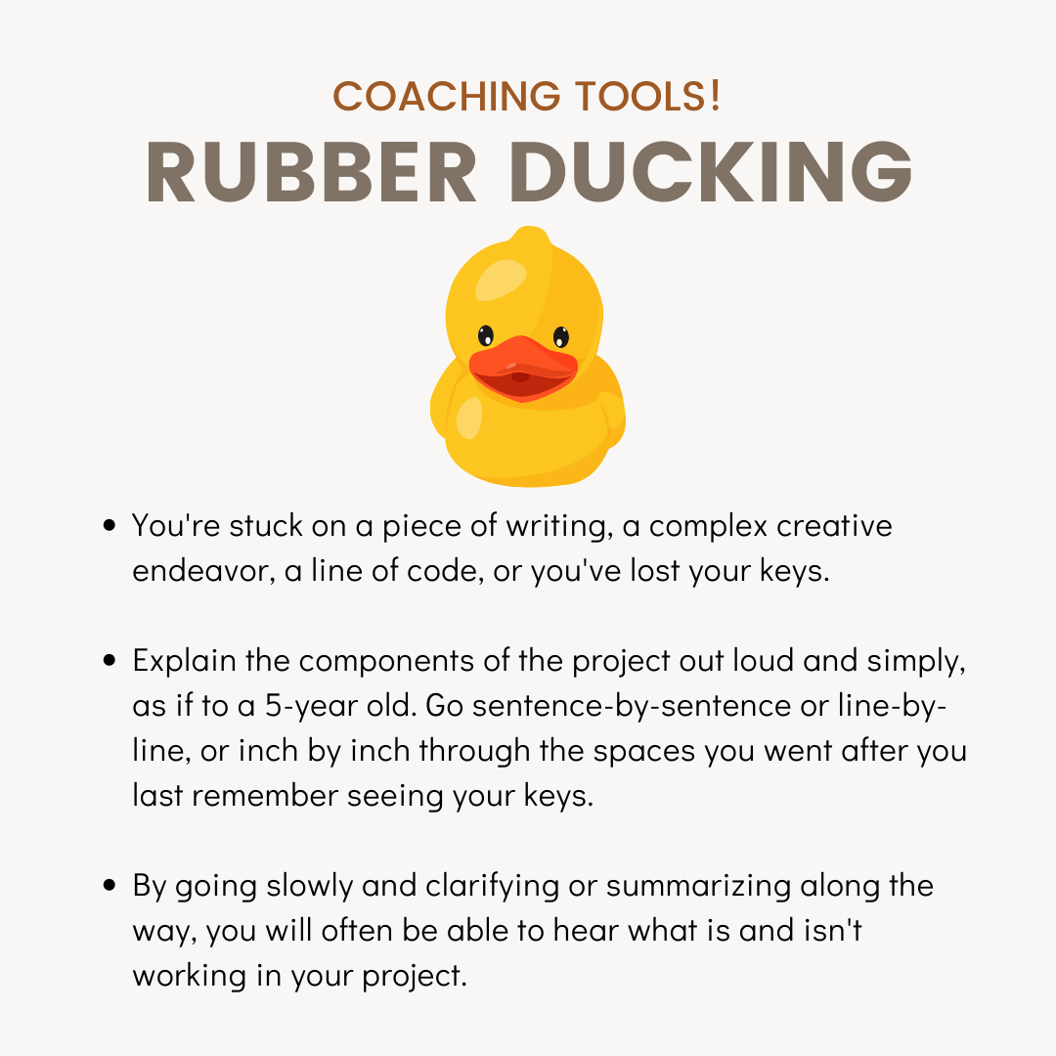
Debugging (Logic Testing)
Check variable explorer in an IDE to ensure values are what you expect
Narrate your code to a friend or a rubber duck (Rubber Ducking)
Use print statements around offending areas
Follow the traceback
Credit: V & CO Coaching

Slide 20
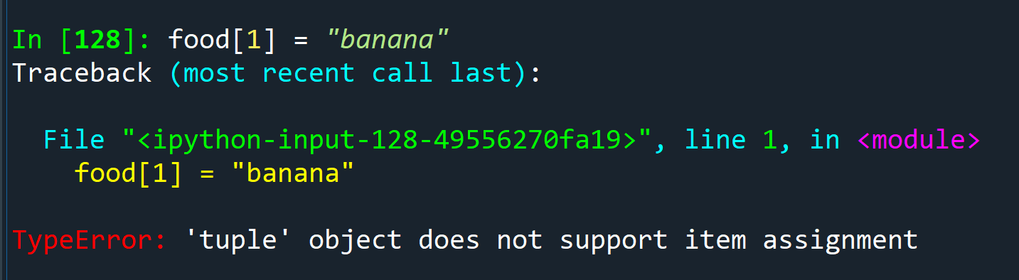
Traceback (BASIC)
Useful for finding offending snippets of code causing errors
Line of offence is usually given
Error message indicates the nature of the issue
If error is unclear – search documentation for library/function or StackOverFlow

Slide 21
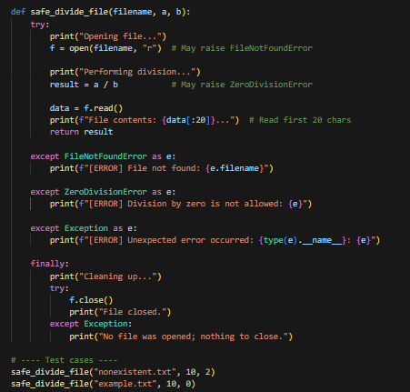
Error Handling
Block | Purpose | Example
try | Encloses potentially failing code | Opening file, dividing numbers
except FileNotFoundError | Catches a specific error | Missing file
except ZeroDivisionError | Catches another specific error | Divide by zero
except Exception | Catches any other unhandled error | Safety net
finally | Always runs, regardless of success/failure | Cleanup, file closing

Slide 22
Methods
Workbook:
Printing (Basic)
Variable Exploring (Basic – Requires IDE)
Error Handling (try, except, finally) (Intermediate)
Unit Test (Intermediate)
Using pdb (the python debugger) (Intermediate)
Using wrappers and decorators (Advanced)

Slide 23
Tangent: Scopes

Slide 24
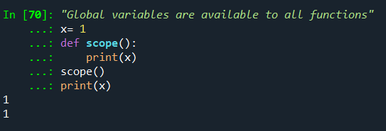
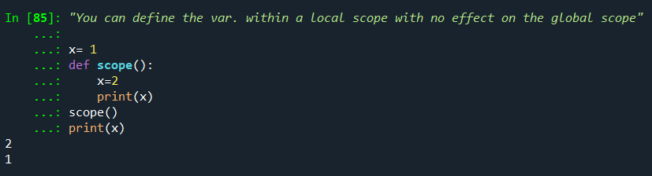
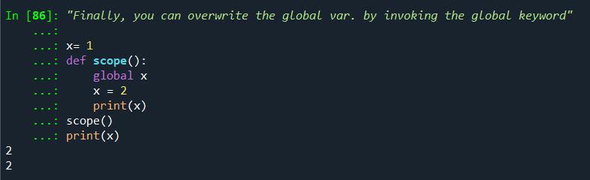
Importance of Scope
Used to describe the access to variables within functions
global variables are accessible to all functions
local variables are accessible within the function/nested functions
You can change variables in the global scope by declaring the variable using the global keyword
Global Access
Local Access
Global Access in Local Scope

Slide 25
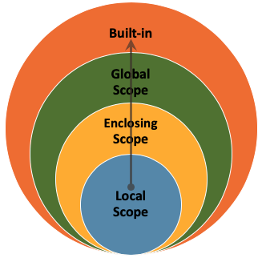
Scope Overview
For nested functions
Credit: Data Camp

Slide 26
Visualisation

Slide 27
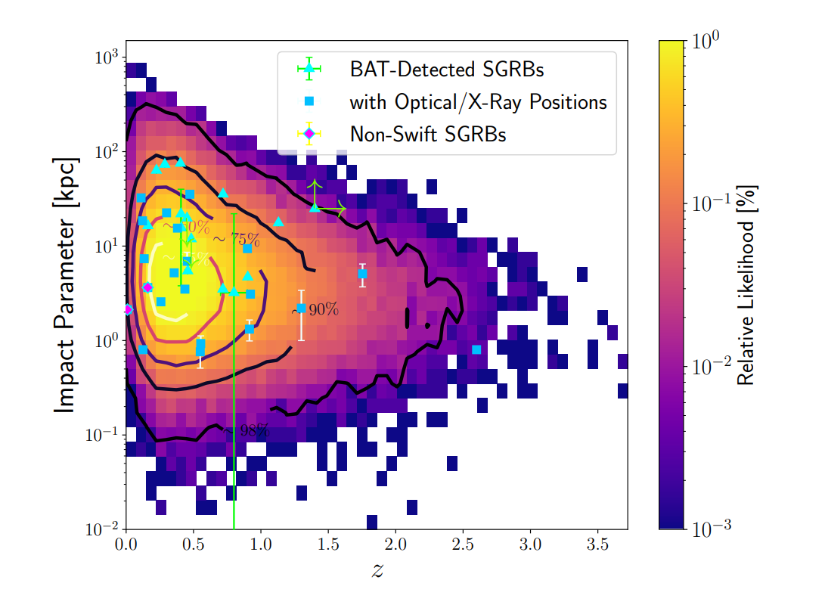
Matplotlib
Check out Josh Hayes’ Guide: https://github.com/joshjchayes/matplotlib_guide
Great for visualising data
Well documented
Main package used for plotting in Python
Image Credit: Mandhai et al., 2022

Slide 28
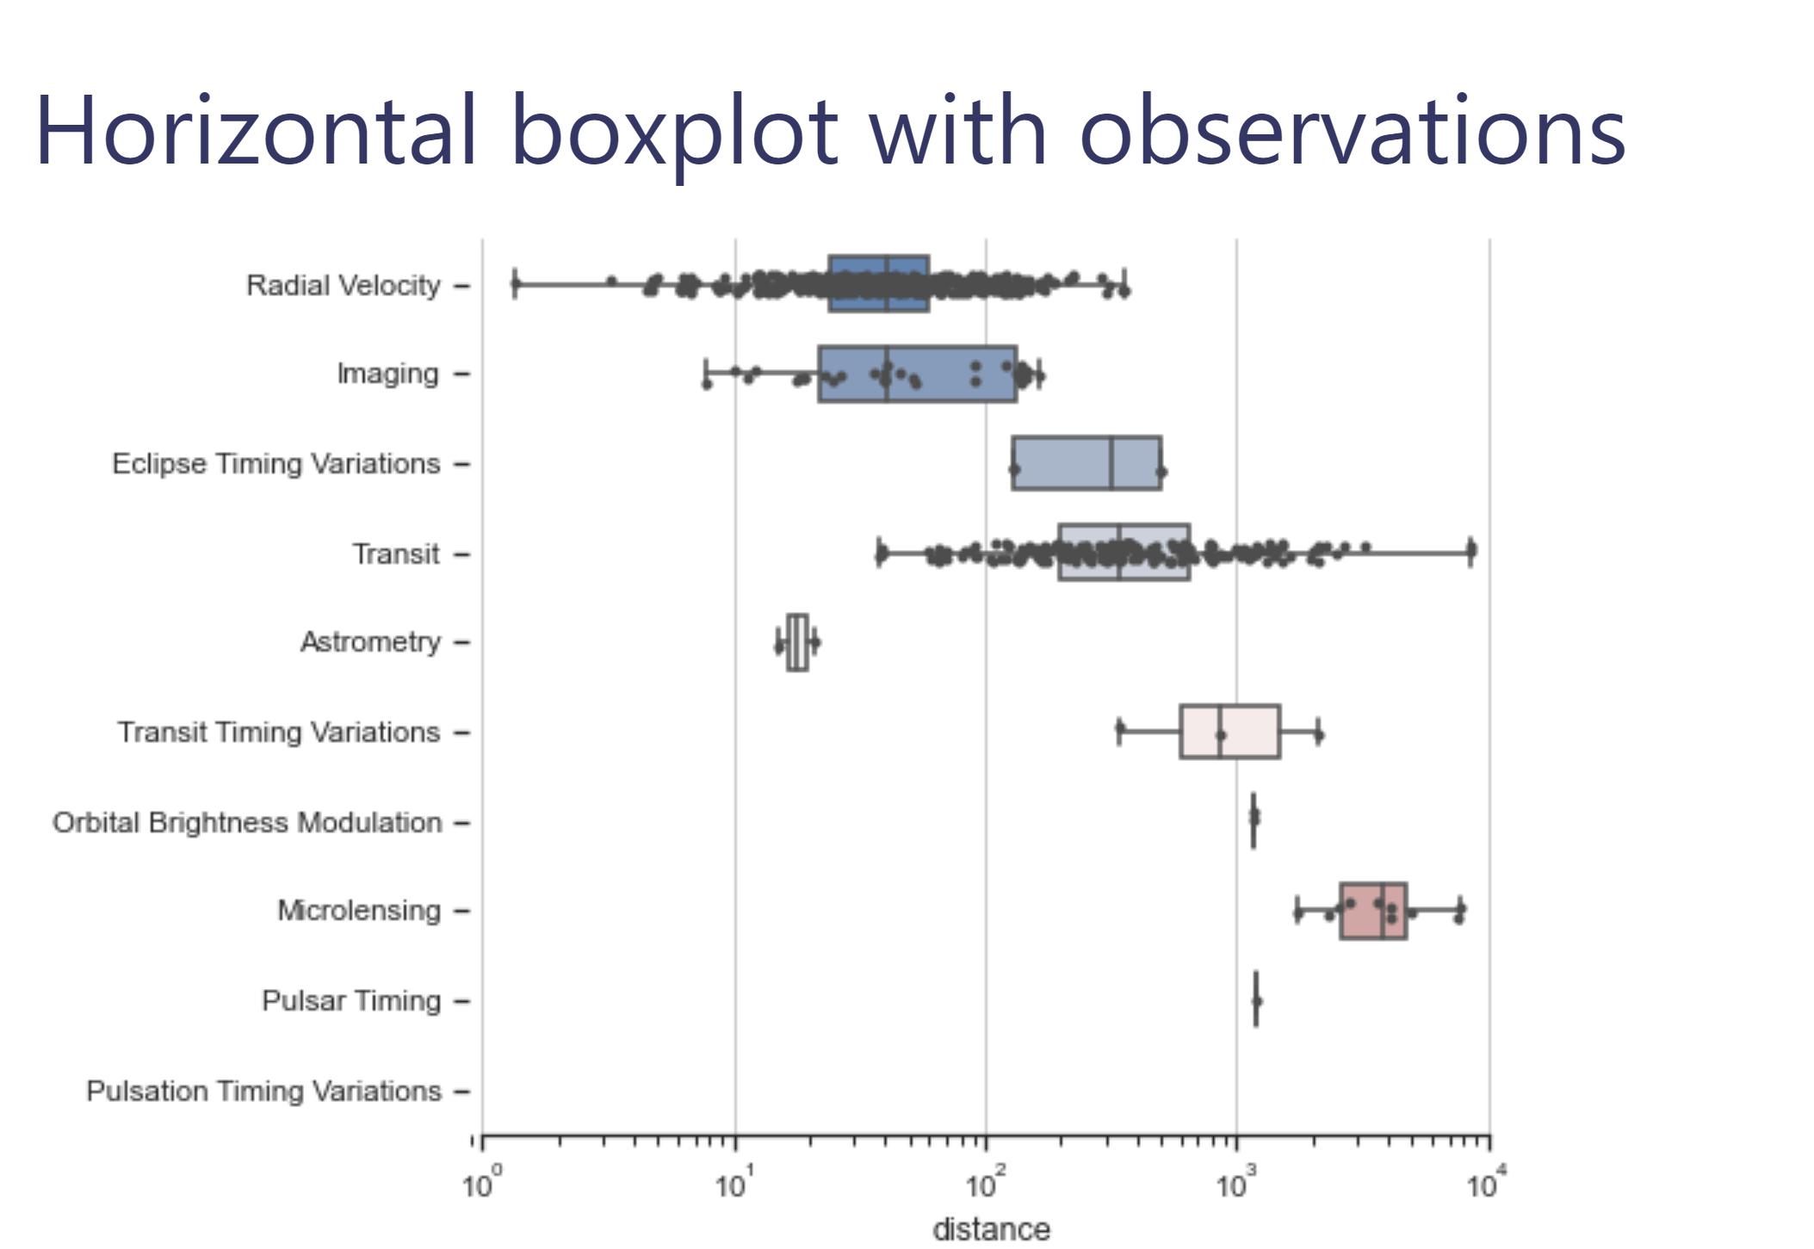
Seaborn
Site: https://seaborn.pydata.org/
Based on Matplotlib
Can load datasets
Convenient for producing statistical graphs
Functions ready to use for creating common types of graphs
Image Credit: Seaborn

Slide 29
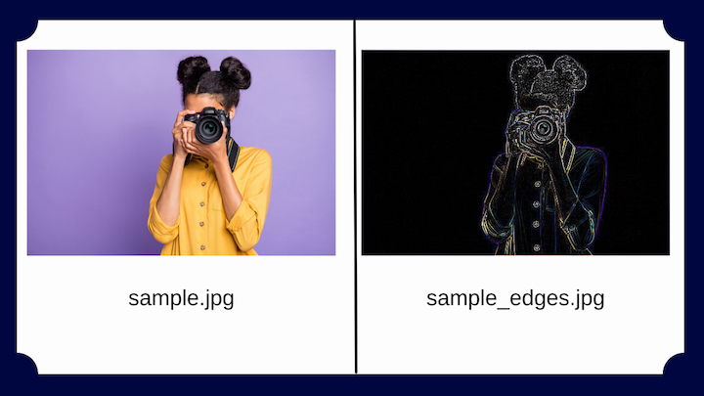
PILLOW
Site: https://pillow.readthedocs.io/en/stable/handbook/overview.html
Designed for loading images
Great for manipulating images
Can be used for art/preparing image data for creating training datasets
Can work in tandem with matplotlib
Can load images directly from a URL
Using pillow – you can create LUTs and image filters
Image Credit: LogRocket Blog - https://blog.logrocket.com/image-processing-in-python-using-pillow/

Slide 30

ACTIVITY TIME
On the padlet:
State: What do you like to see in graphs and plots?
Which features do you tend to dislike in plots?
Do you have any cool figures? If so, add them do the padlet.
URL: https://padlet.com/soheb_mandhai/jacs-2022-2023-padlet-xpcfpmv22utnsrza

Slide 31
Good Practices

Slide 32

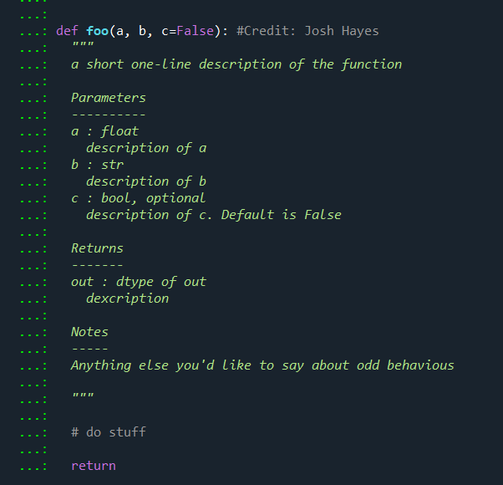
Things to do:
Good Comments:
Commenting your code will make it easier to revisit in the future.
Lets other people understand what you have done.
Makes it easier to identify mistakes in logic
Sensible Variable Names: Give your variables useful names that link back to the context
Documenting your functions: Creating a doc-string will make it easier for you to understand the structure and inputs of your function.
Use ?*function name here* to check docstring

Slide 33
TIPS & Common Pitfalls

Slide 34
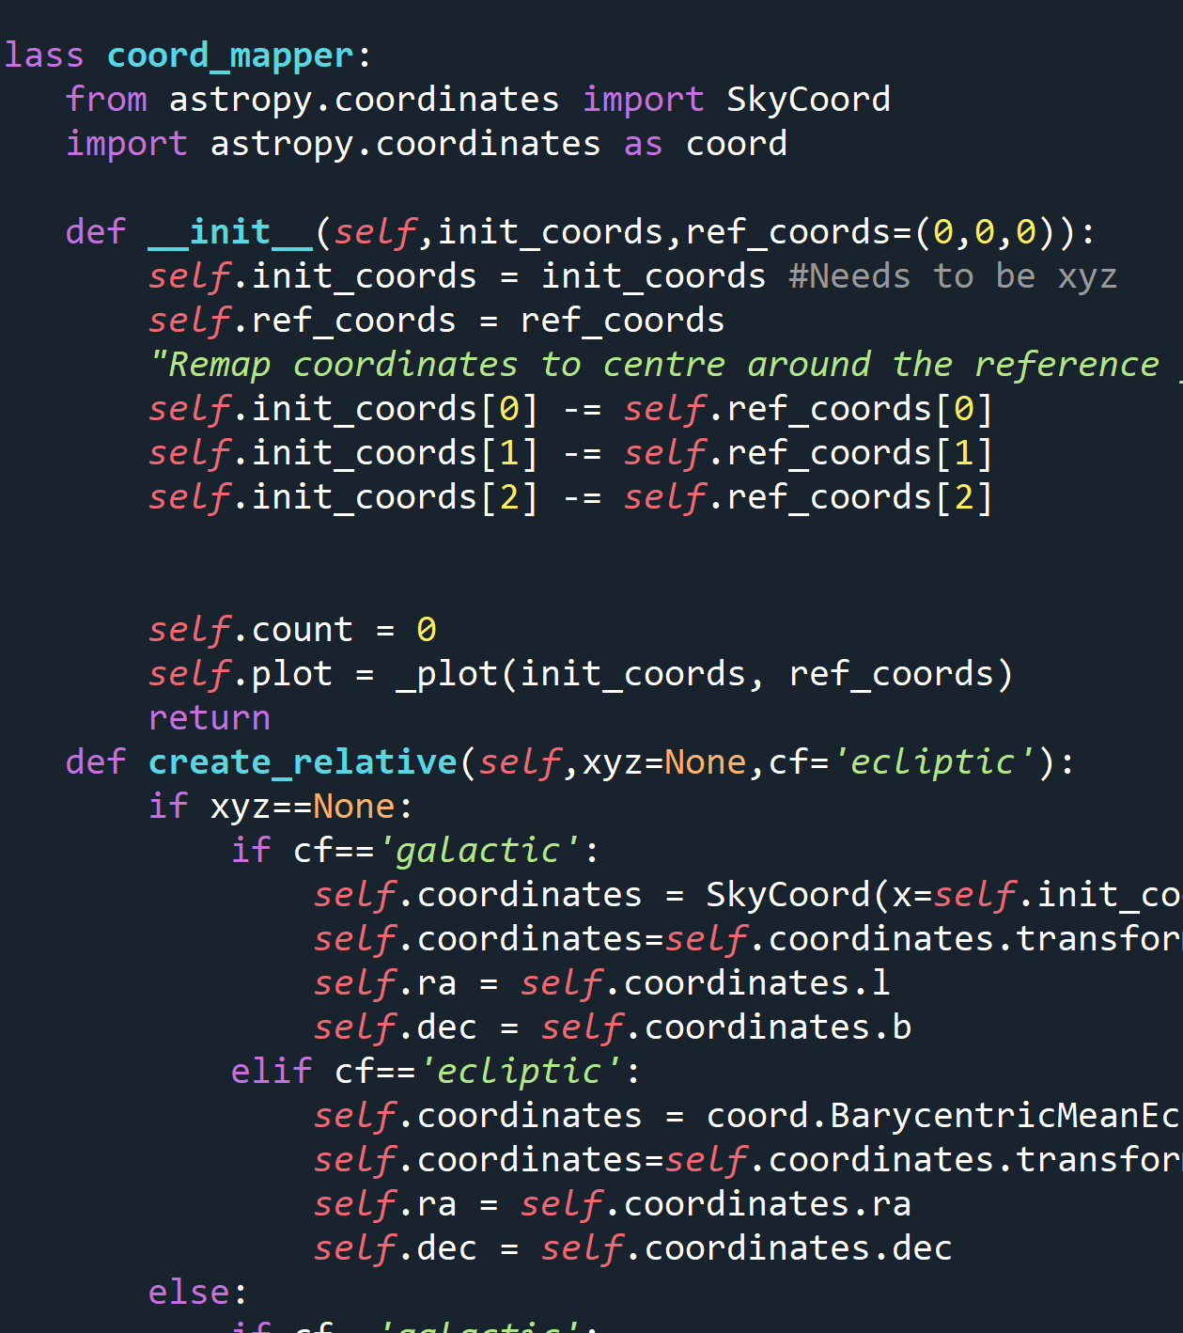
No/Poor Commenting
YES, I’M GUILTY OF THIS
Comment your code:
Helpful if anyone else reads it
Will save you time in the future
“The worst collaborator you can ever have is you from a year ago – they will never answer emails” – Dr. Josh Hayes, 2022

Slide 35
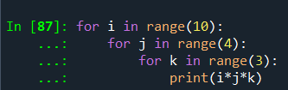
Excessive Looping
YES, I’M GUILTY OF THIS x2
Excessive looping is inefficient and can slow down your code
Some packages like NumPy have routines to avoid looping for mathematical calculations using precompiled C functions.
Itertools and map (uses multiprocessing/threading) are alternatives that can be used if you must have multiple loops

Slide 36
Confusing Variable Names
YES, I’M GUILTY OF THIS x3
Pick sensible names that suit the context of the values contained in the variable.
Bad variable names can cause trouble when debugging/re-reading the code years later.

Slide 37






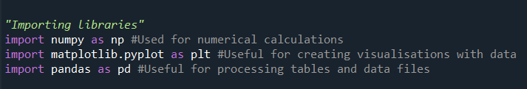
Common Libraries

Slide 38
Additional Resources

Slide 39
Need Help?
StackOverFlow
Your Colleagues
W3Schools
Coding Academy
Many More…

Slide 40
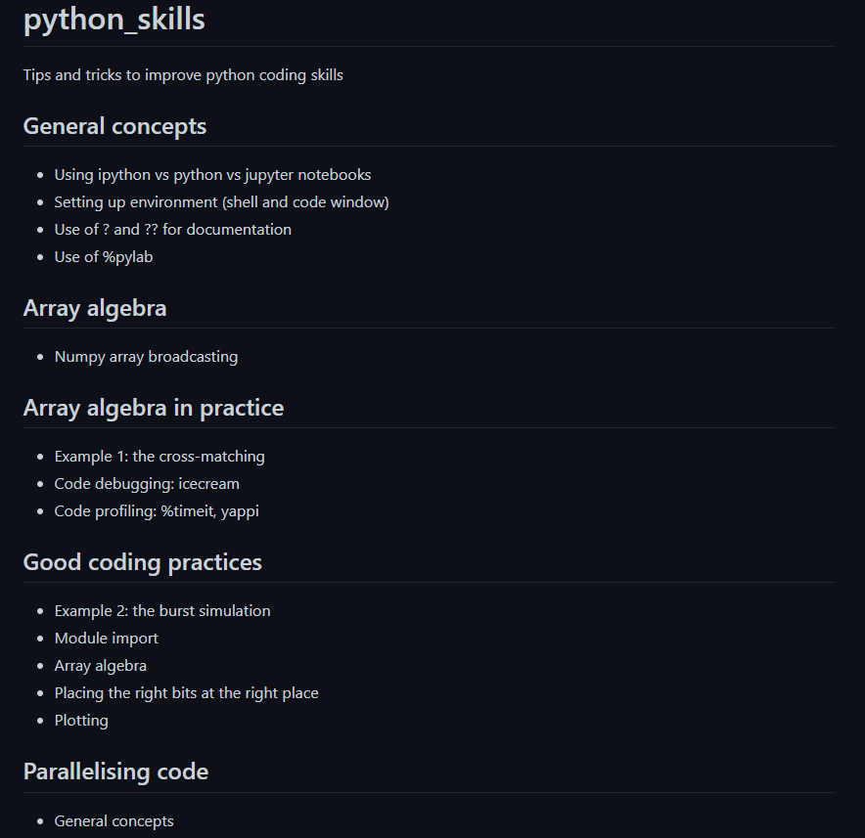
Want to be a Python Jedi?
Check out Rene’s JACS material from previous years - https://github.com/bretonr/python_skills

Slide 41
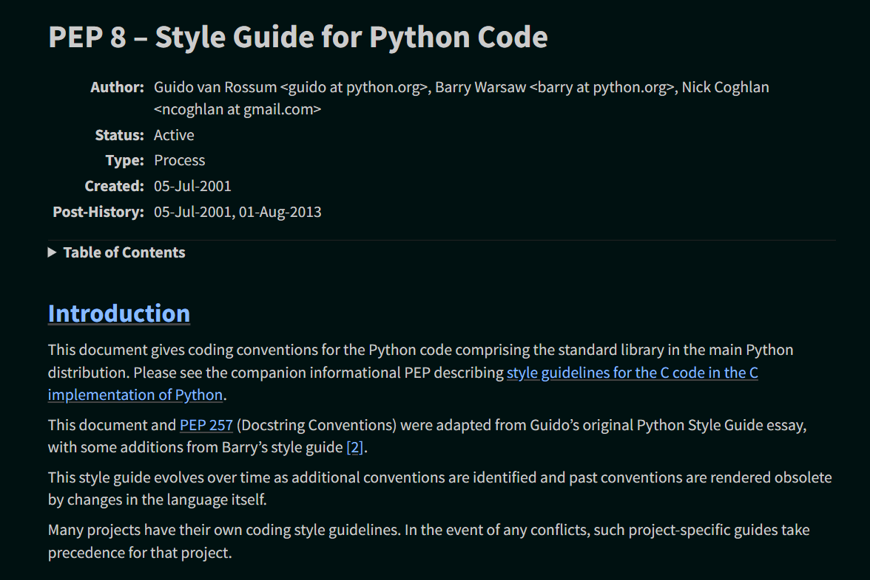
PEP-8 Documentation
Style Guide for Python Code- https://peps.python.org/pep-0008/

